Slide 1

Unified Gateway Overview March 2025
Nir M Kol UGW CPO
Ohad Navon UGW PO
Tamir Menahem UGW Architect
Raya Koren and Yarin Israeli UGW Enablement

Slide 2
Agenda
Motivation
Service overview and Status Quo
High Level Service Architecture
Q&A

Slide 3
Unified Gateway (Technology Guidelines 45)
Establish an SAP centrally managed, globally distributed ingress layer that acts as entry point to all SAP cloud solutions.
Data center (4+1)
UGW TG45
LoB
Gradually and incrementally offload cross-cutting concerns to increase development efficiency with minor impact on the applications
Assess necessity and the technical implications of tailored and legacy capability (maintain, reimplement or decommission)
Offer and manage harmonized endpoints to ease IES integration and extension (long term goal).
Routing
JWT Validation
LoB Application / Service
DNS
Certificate management
DNS management
Client (Browser/Application)
Ingress http traffic
Client
App/Browser
CDN
API Insights (TG46)
Distributed Tracing
Certificate Authority
Rate limit
WAF
IP Geo-Blocking
And more...
Offloading cross cutting concerns
While complying with the SAP CAT-1 Kernel service qualities:
Co-Deployment to all SAP DCs
Support all SAP platforms (4+1) and DCs (>52)
Superior service SLA ≥ 99.99%
Low latency (Median 3 ms)
Elasticity to support LOB needs
Low and optimized TCO
Decoupled Life cycle from LOB’s
Comply to ALL SAP supported certifications and regulations (PCI, ISO/SOC, FIPS, EU, MENA, etc.)
Notes:
Benjamin/Ohad
Co-deployment
4+1
Regulated market (
GovCloud
SAP Specific certifications (ISO, SOC, PCI, FIPS. etc.)
SAP Standards and TG complaint
LOB specific capabilities

Slide 4
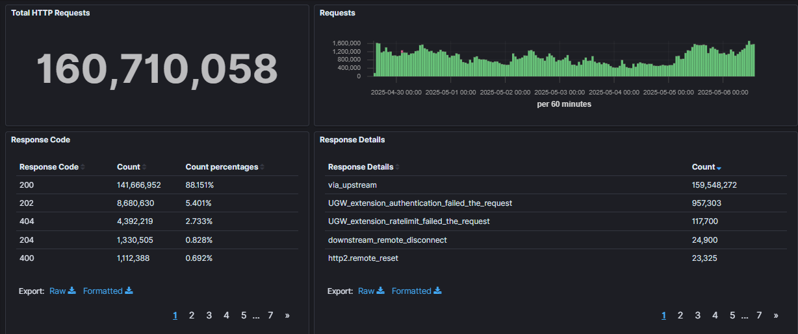
UGW Service Status
UGW is a GA service
It handles productive traffic since March 2023.
We completed 2 successful frontrunners, and an additional one is about to end in August.
UGW is productively adopted by 16 cloud solutions:
S4/Digital Manufacturing Cloud
Cloud ERP: Order Management Services
3 Industry Cloud solutions: Revenue Growth Management, Returns Management and Data Ingestion
Signavio – Legacy and BTP based services
BTP/Decentralized Identity Verification
SAP Community
It served more than 160 Million productive HTTP request in the last 7 days (>600 Million per month).
Healthy adoption pipeline including various LoBs cloud solutions, such as CX/FSM, One Procurement, S/4 Cloud ERP
It is ISO, SOC and PCI DSS Certified service

Slide 5
UGW Current Point of Present – 20 PoP (Updated: May 2025)
As a CAT-1 Kernel service UGW should be co-deployed with the workload it serves - the deployment is based on LOB demand, targeting ALL SAP supported regions/DCs (FKA OneStrike DCs)
Aligned with BTP everywhere, UGW will be deployed to all BTP regions
Azure
AWS
Azure
GCP
Azure
AWS
AWS
GCP
Azure
AWS
Azure
GCP
AWS
AWS
AWS
AWS
AWS
GCP

Slide 6
UGW Current Features
Traffic Management and Optimization
Traffic Monitoring & Observability
Secure Traffic
DNS Management & Common super Domain L1
Host based Routing
API Insights Logging (TG46)
Generate and log Request ID
Certificate & TLS management
IP Geo-Blocking
Certificated management
Path and variable based routing (Common Domain)
HTTP access logs
Performance and SLA metrics
Static Ingress IPs
Upstream mTLS
Headers manipulation (add)
Custom Variables based on request attributes
Tenant identification based on custom expression
mTLS to LoB & Client
Rate limit
Limiting Requests by Size
Authentication e.g. JWT validation, (soon) client certificate
Main Features | Unified Gateway
Notes:
Gradual adoption by LOB

Slide 7
DNS, Certificate and Routing
UGW support Domain Intercepting via DNS Delegation
By creating a CNAME record on your DNS account e.g. application.cloud.sap CNAME application.cloud.sap.alias.live.pu.ugw.cloud.sap
The delegation is a non-disruptive change for the clients and reflected based on the TTL to all clients
UGW automatically manages the certificate lifecycle and follow the SAP’s guidelines.
The certificate is issued from the Certificate Authorities (CAs): DigiCert or Let’s Encrypt.
After UGW processing the request is routed to the defined upstream. UGW supports:
Host based routing
Path based routing
Custom variable based routing

Slide 8
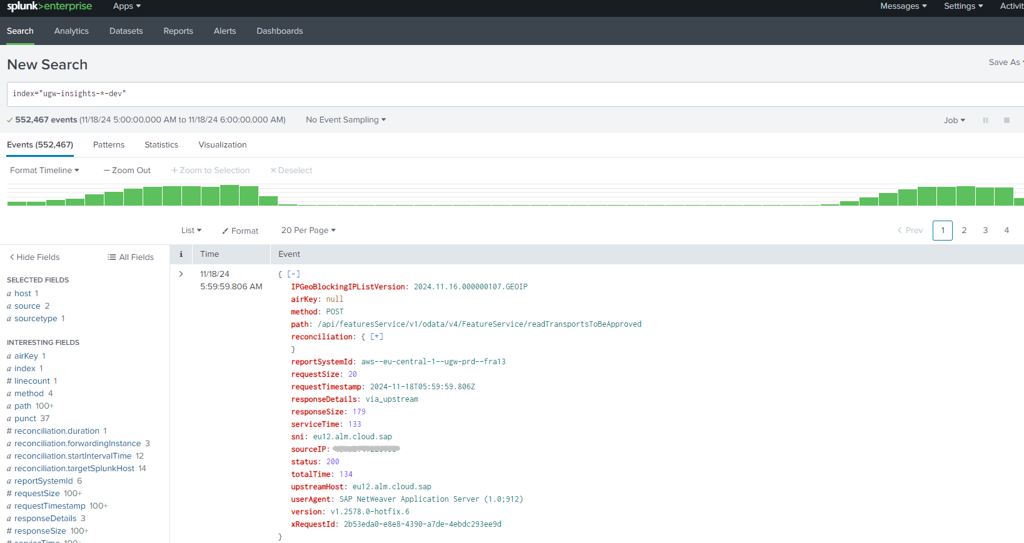
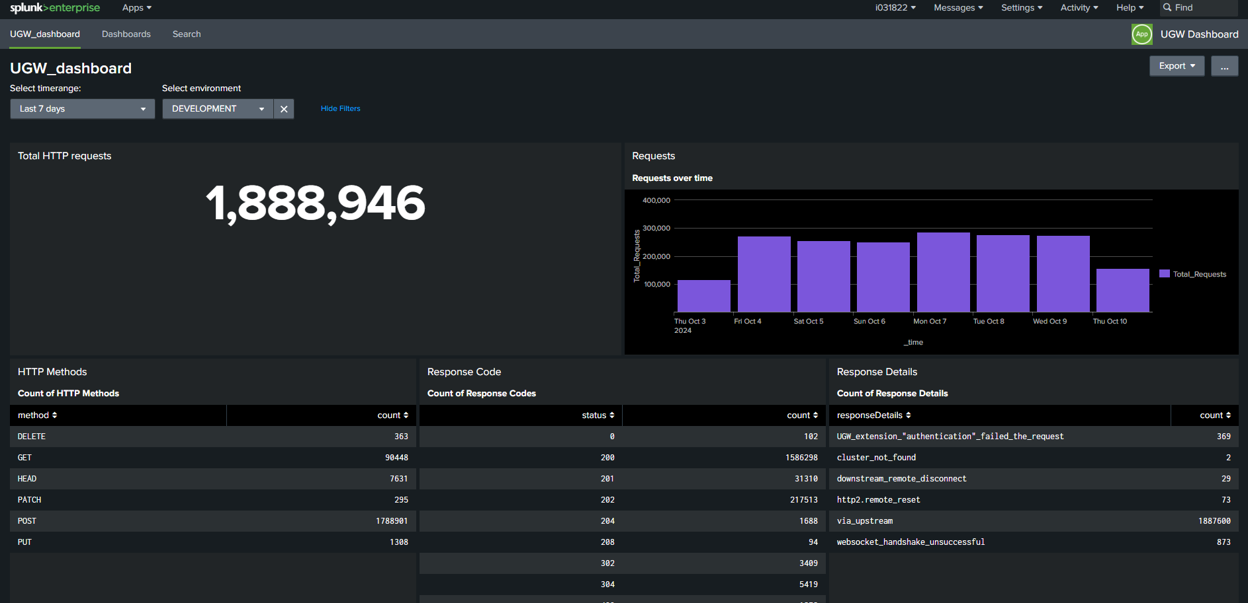
HTTP Access Logs Observability in SIEM Splunk
UGW collects the HTTP Access Logs and sends them to your SIEM Splunk
Default attributes are aligned with the requirement from SGS, API Insight (TG46)
Access logs can be extended based on the UGW custom variables

Slide 9
Rate Limit
Unified Gateway allows you to control the traffic rate routed to the upstream by configuring Rate Limit policies.
Rate-limit policies may include multiple rate-limit rules that defines the time window, threshold and counting attributes (Count by and filter by)
All defined rules coexist and will be considered by UGW
The rate limit policy can be configured on a host level, or on a specific Route (path or custom variable based)
UGW reports as part of the access log dedicated property related to the Rate limit calculation results:
RateLimitLimit: 3000 RateLimitPolicy: 3000;w=1;r=global-rate-limit-policy.tenantBasedRL RateLimitRemaining: 2997 RateLimitReset: 1

Slide 10
UGW Potential Future Direction
Traffic Management and Optimization
Traffic Monitoring & Observability
Secure Traffic
DNS Management
Host based Routing
API Insights Logging (TG46)
Generate and log Request ID
Certificate & TLS management
IP Geo-Blocking
Certificated management
Path and variable based routing (Common Domain)
HTTP access logs
Performance and SLA metrics
Static Ingress IPs
Upstream mTLS
Common super domain (L2 & L3)
Headers transformations
Custom Variables based on request attributes
Tenant identification based on custom expression
mTLS to LoB & Client
Rate limit
Static edge caching (based on CDN)
Smart routing
Friendly traffic identification
Geographic traffic visualization
Limiting Requests by Size
Authentication e.g. JWT validation, client certificate/
Edge global server load balancing
API Content optimization e.g. compression, traffic shaping
Abnormal traffic patterns alerts
Distributed tracing
Web Application Firewall (WAF)
IPS/IDS (Intrusion Detection & Prevention system)`
Geo-steering
And more…
Packet Inspection / Low level protocols
And more…
NDR (Network Detection and response)
Private network
Available
Planned / Opportunity
Notes:
Gradual adoption by LOB

Slide 11
Unified Gateway Architecture

Slide 12
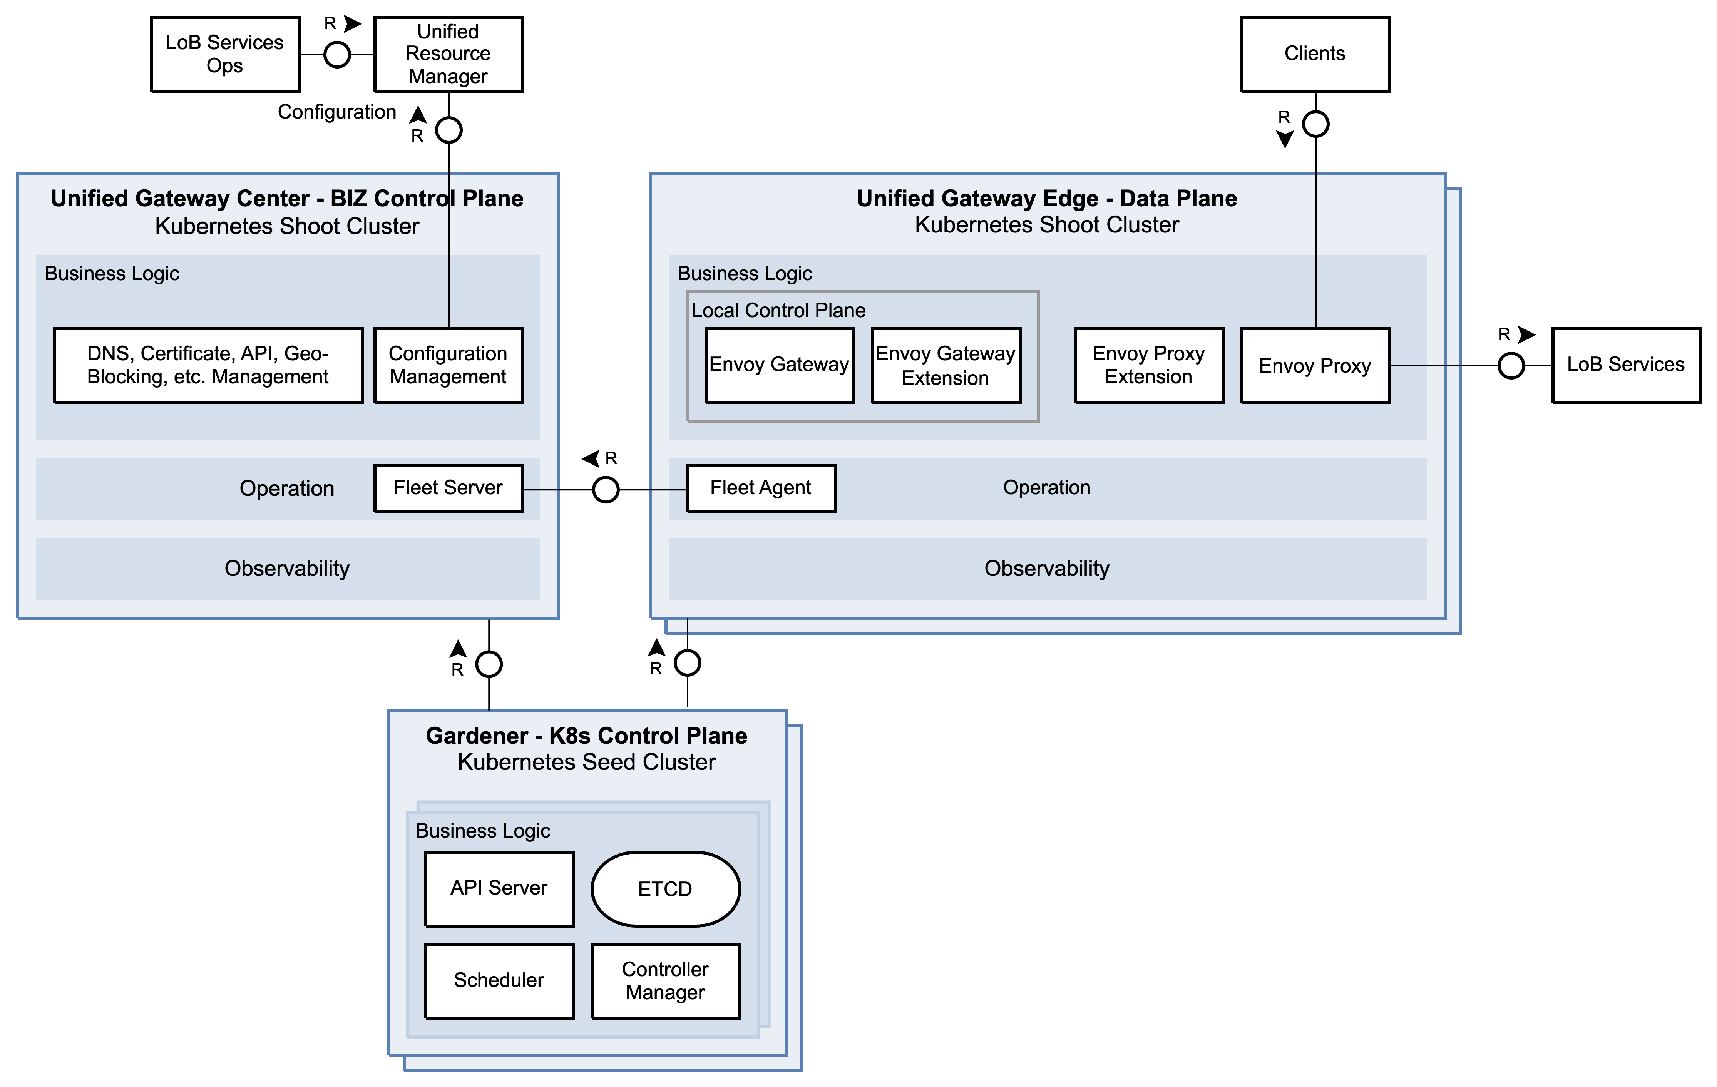
Abstract System Architecture
Center
Business control plane
Design-time – Installation and Configuration of Edge clusters
Single data center
Stateful – Meta-data of LoBs (e.g., API, domains)
Edges
Data plane
Runtime
Multiple data centers
Stateless
Local proxy control plane
Gardener
Kubernetes control Plane (Kubernetes Clusters as a Service)
Installation and configuration
Runtime
Notes:
ATOM CFS: https://github.tools.sap/cfs/cfs-services
Unified Resource manager: https://github.tools.sap/cfs/cfs-services/tree/master/resource-manager
Shoot Kublet, Calico, Kube Proxy, Core DNS to Seed (Shoot) API Server
Seed (Shoot) API Server - VPN to Shoot (Pod, Nodes)
Declarative (desired state) – include asynchronous reconciliation

Slide 13
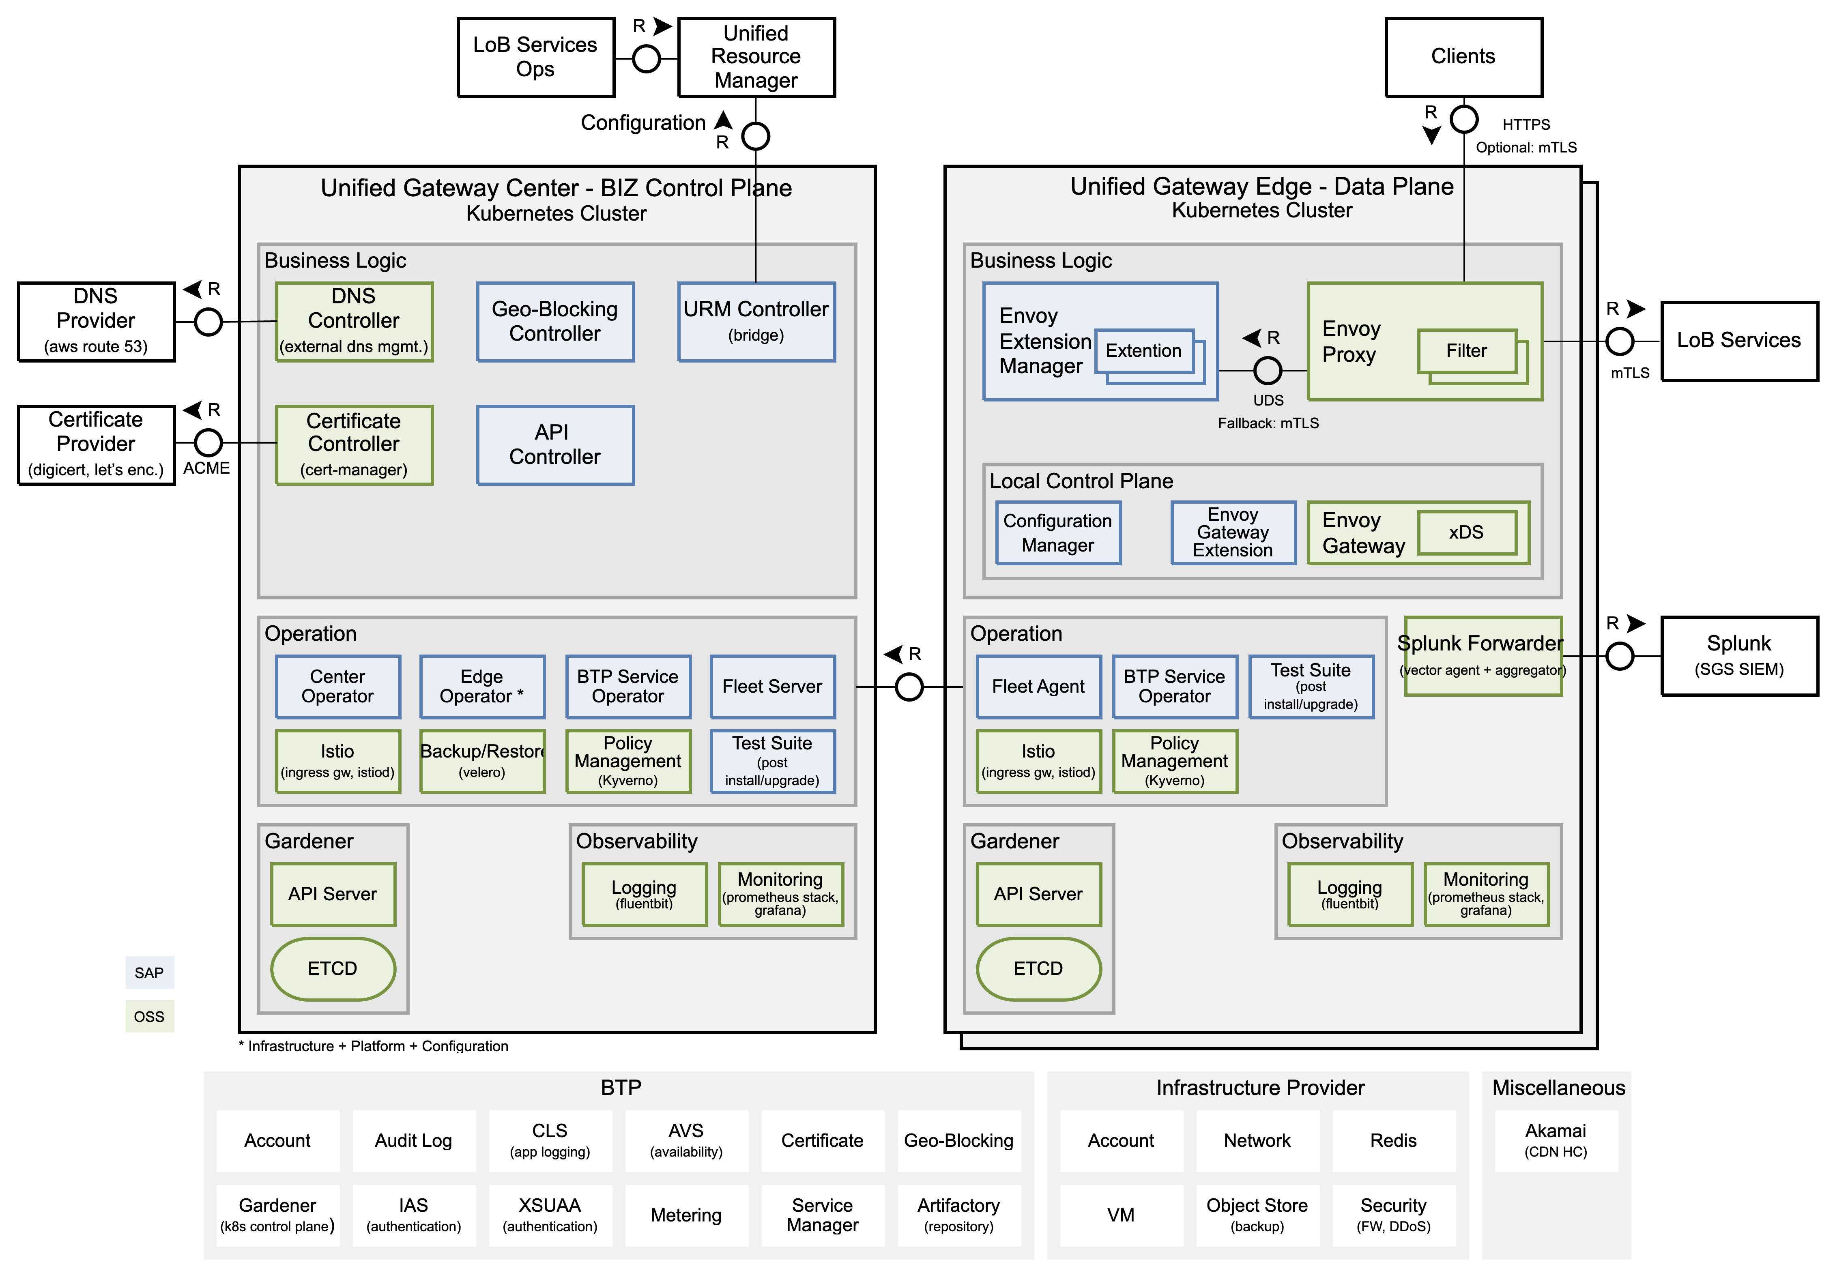
System Architecture
Center vs. Edges
Worker Group
Isolate critical runtime
Kubernetes
Managing containerized workloads
Declarative (desired state) – asynchronous reconciliation
Gardener
Seed – Kubernetes Cluster Control Plane
Kubernetes Shoot Cluster
Envoy Gateway
Own configuration API schema
Decoupled from the underlying chosen technology stack
Hyperscalers: AWS, GCP, Azure, Planned: SAP Converged Cloud, as part of BTP everywhere
Kernel Service
Mandatory technical services for all SAP cloud solutions – consistent Experience across the entire portfolio
CAT-1 – Hyperscaler Region Consumption – Deployed in each Hyperscaler region (all Tiers)
Notes:
EDP – Event Data Platform
Istio – Plutono (previously Grafana) access, URM WebHook, Fleet management
xDS Dynamic Resource Discovery

Slide 14
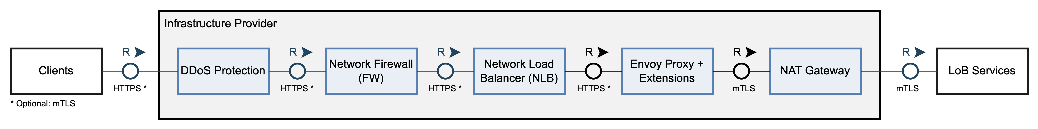
Runtime (Critical Path)
Network Load Balancer (NLB)
Network / Classic (Transparent) L4 LB
Passthrough
Adds proxy protocol header (client-IP)
Provides ingress static (stable) IP
Envoy Proxy
Application L7 LB
TLS Termination
Examines HTTP request header
Transparent as possible - maintains common reverse proxy HTTP headers:
NAT Gateway
Network Address Translation L4
Maps IP address by modifying the IP header of packets
Provide egress static (stable) IP
Miscellaneous
Envoy Proxy
Multi-Instances
Multi-AZ (Availability Zone)
Separated VMs (Worker Group)
Horizontal Scaling (Kubernetes Autoscaler)
CDN and other proxies may be in-front of UGW
DDoS, FW – L4
X-Forwarded-For (XFF) and True-Client-IP
X-Forwarded-Host (XFH) and X-Forwarded-Path
X-Forwarded-Proto (XFP)
X-Forwarded-Client-Cert (XFCC)
X-Request-ID
Notes:
https://pages.github.tools.sap/unified-gateway/main_features/header_manipulation/headers_manipulated_by_ugw
DDoS paid plan guided by SAP Multicloud (owner: Stephen Dobbins)
Azure: https://learn.microsoft.com/en-us/azure/ddos-protection/ddos-protection-overview
GCP: https://cloud.google.com/armor/docs/armor-enterprise-overview
AWS: https://docs.aws.amazon.com/waf/latest/developerguide/ddos-overview.html
DDoS: https://wiki.one.int.sap/wiki/display/SAPMS/DDos+Protection, https://workzone.one.int.sap/site#workzone-home&/groups/rfjLPU42pSuICiflCl7pMp/workpage_tabs/E2JAstTDlMyKeH4KecGOOx, https://wiki.one.int.sap/wiki/display/unifiedgw/DDOS+Protection+in+UGW
Lack of IDPS (Intrusion Detection or Prevention System): https://github.tools.sap/I310688/ugw-idps/blob/main/README.md
Currently still not mandated by the current SAP Product Standards.
Not instead of LoB VPC.
Current UGW scope is HTTP level, which limits the utility of IDPS for its operational needs.
Challenges with IDPS integration regards the decrypted data on the network level that lowers the overall security effectiveness.
High cost due to the necessity of transferring all traffic from multiple disparate networks to a centralized collection point.
WAF as a Priority: a WAF can help potentially leveraging specialized signature rule sets to mitigate certain related risks.

Slide 15
Edge HA (Redundancy)
Edge Cluster
Active-active
Stateless
Multi-AZ – Machines are located in 3 zones
[in-addition] Clusters with previous version (failover)
AVS
SAP BTP Availability service – monitor cloud-based applications
Used by Cloud Engineering 24x7 support team
[Future] Opportunities
Routes from different regions
Global Server L4 LB (“GSLB”) – Increased number of PoP (point of presence)
Smart routing (region-less domain support)
Notes:
Availability SLA calculation: https://uptime.is

Slide 16
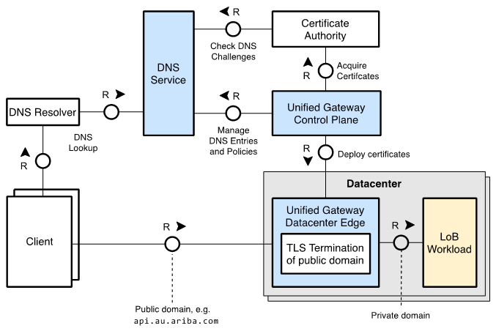

DNS and Certificate Management
Automate DNS and Certificate management
One time setup: DNS delegation to UGW
Enable LoB cross-platform, cross-product, and cross-tenant central domain unification and control
Example: Same domain can be used to access CF/Kyma and LoB legacy landscape
Enable control and visibility to central SAP teams, such as SGS and IT
Future opportunity: domain migration feature, include domain coexistence, blocking new customers, deprecation warning and redirect
More information, Guide 1, Guide 2
Notes:
CSD L1: *.[product].cloud.sap – crm.cloud.sap
CSD L2: [opt-prefix].[product].[tenant].[common-suffix] – api.s4hana.mycorp.cust.cloud.sap
CSD L3: [opt-prefix].[product].[customer-suffix] – api.s4hana.mycorp.de

Slide 17
Rate Limiting
More information, Guide
Notes:
https://github.tools.sap/CPA/api-guidelines/blob/main/docs/rest-guideline/06-http-protocol-binding.md#rate-limiting
Future: App Log and Audit Log via OctoRoute

Slide 18
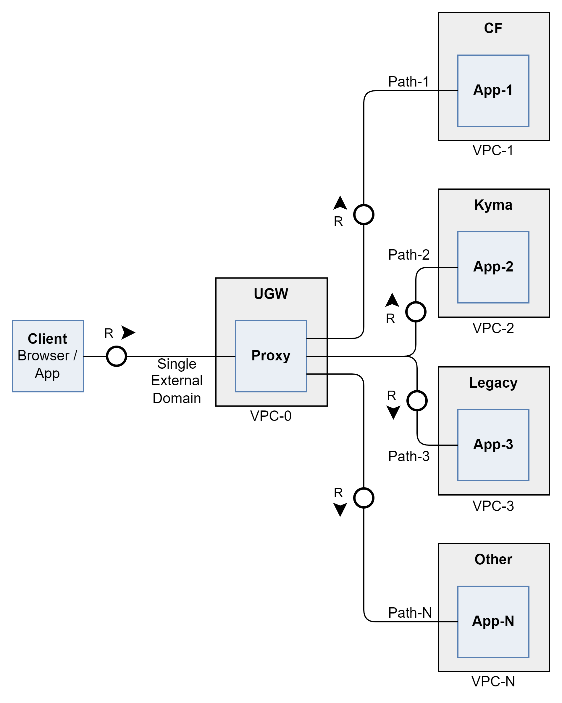
UGW is workload Technology Stack Agnostic
UGW runs side-by-side to the endpoint it serves (outside of the workload VPC) and communicate with the workload based on HTTP Requests.
The communication to the upstream is done securely using mTLS (private network is planned).
UGW is agnostic to the workload technology stack.
Traffic compatibility, for brownfield solutions should be checked as UGW strive for higher security configuration (protocol versions, TLS settings and more)

Slide 19
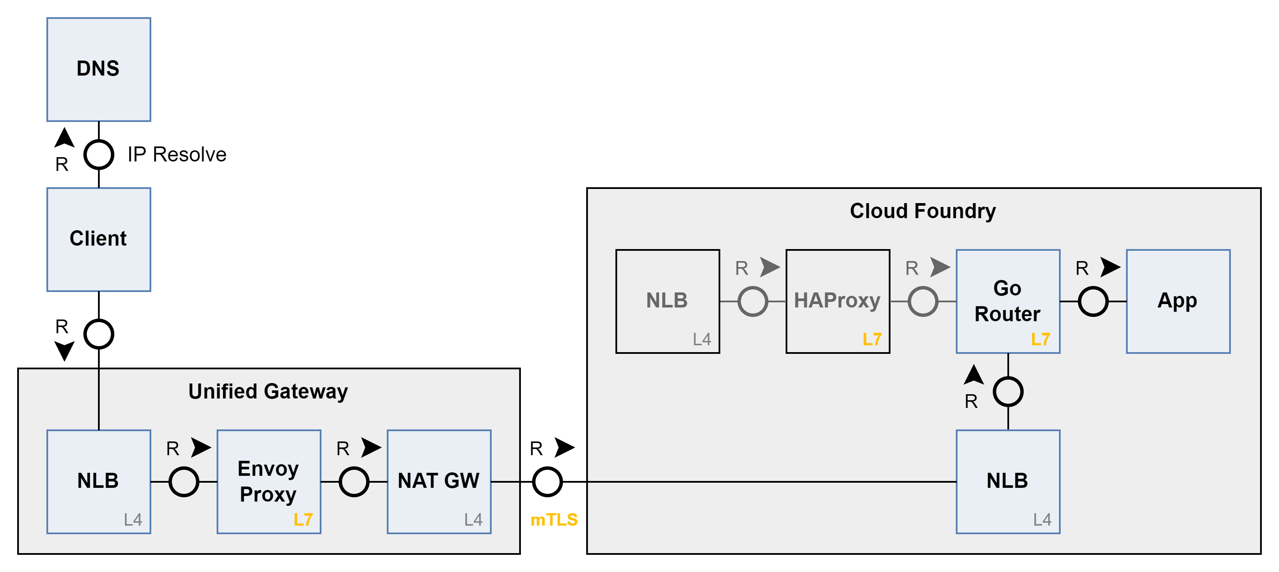
Cloud Foundry Integration
For BTP Cloud Foundry environment a “special”, easier to use integration was introduced, to streamline the adoption of UGW. (Streamlined integration for BTP Kyma is planned)
UGW runs side-by-side to Cloud Foundry Stack on the same hyperscaler datacenter, with an optimized integration:
No additional L7 proxy is added
Eliminating the application domain and certificate TCO
Adoption of UGW is done in an opt-in mode per application domain, with full control based on DNS on the gradual exposure and potential rollback.
The adoption include, configuration of UGW Configuration on cloud foundry, and DNS delegation. No code, just configuration

Slide 20
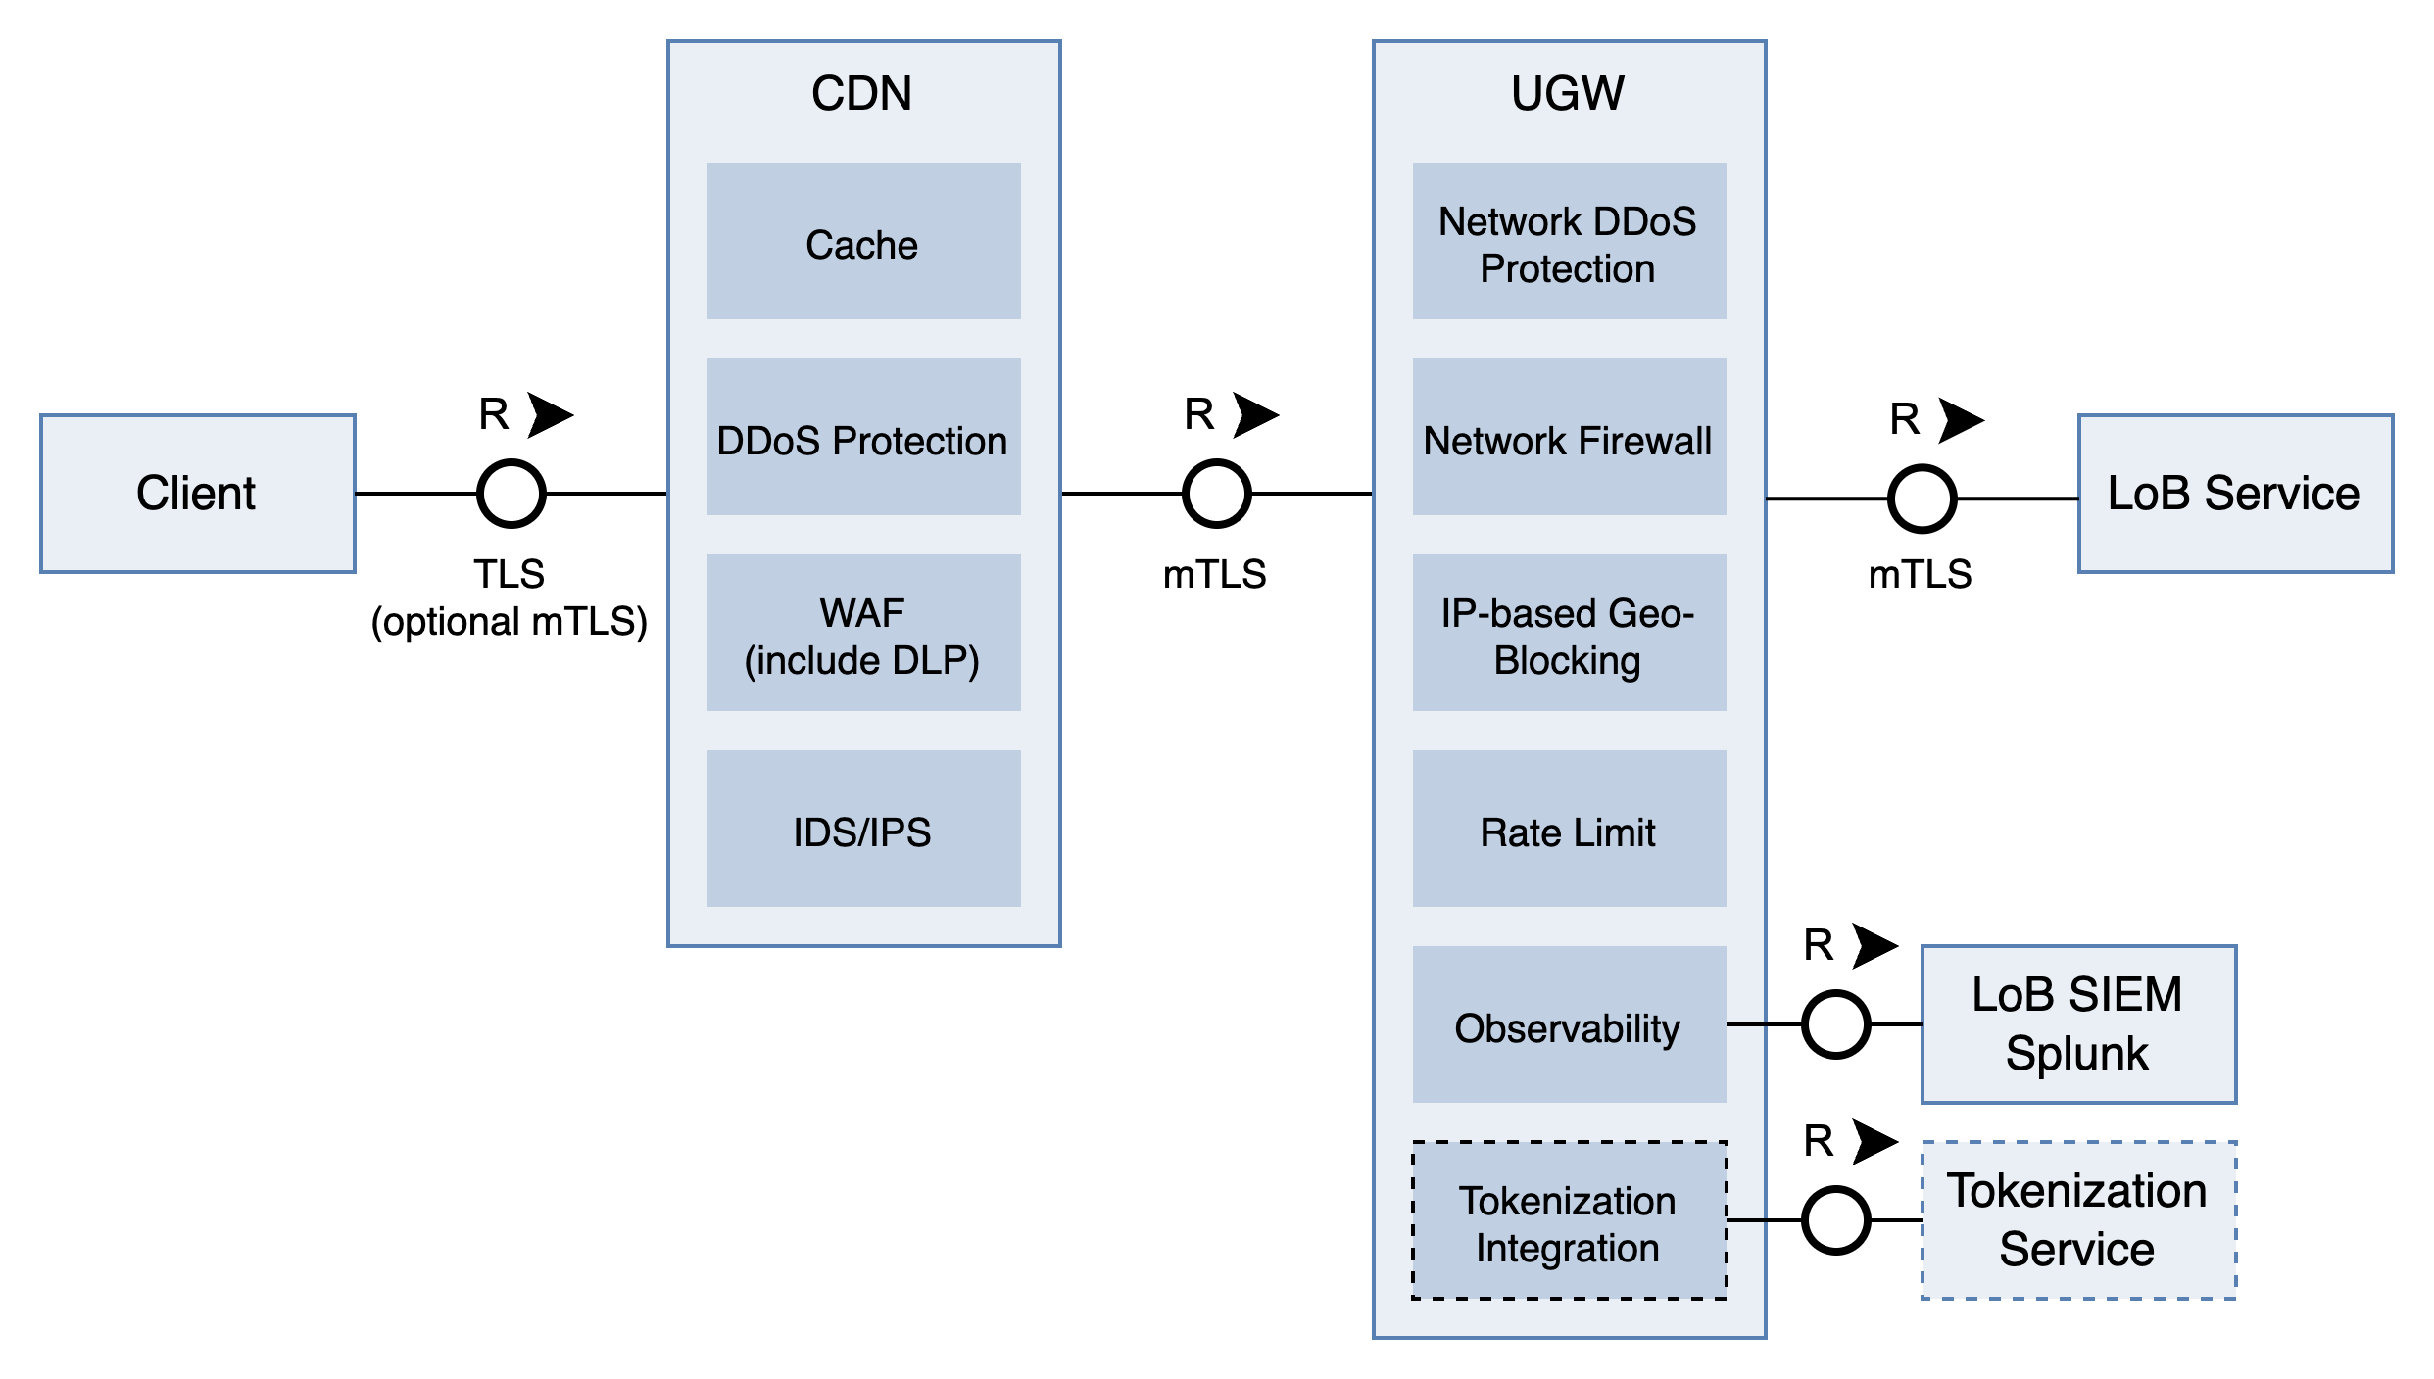
CDN (Edge Computing)
Planned

Slide 21
AI Gateway in Envoy Gateway

Slide 22
AI Gateway – References
Potential new opportunities leveraging AI Gateway's advanced capabilities within UGW:
Guardrails for both requests (prompts) and responses, focusing on sensitive and legal aspects
LLM-token-based rate limiting (request and response)
Metrics and observability
Prompt cost optimization
Prompt enhancement
Interpretation and contextual adaptation of MCP and A2A protocols.
Community and reference:
Envoy Gateway Community: Capabilities | Envoy AI Gateway
Envoy Plans to support MCP Proposal: Envoy Support for Model Context Protocol (MCP)

Slide 23
Unified Gateway Onboarding kit

Slide 24
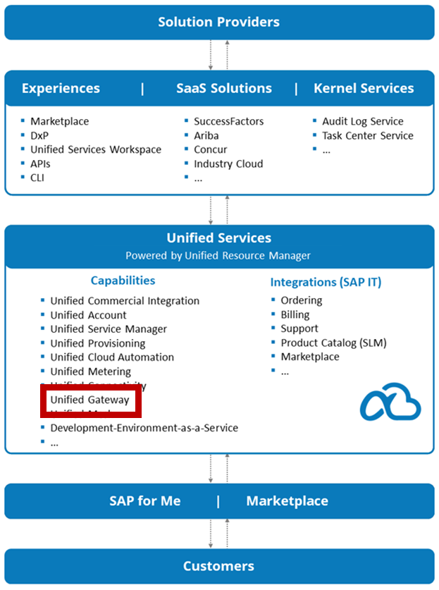
Unified Gateway Configuration
UGW is part of the Unified Services offering, leveraging it to provide a standard, modern interface for other services to provision and consume UGW.
The interface is declarative, and can be used via a CLI, HTTP-based RESTful APIs and a Graphical Interface, allowing to fit into the LoB pipelines and DevOps existing processes (e.g. GitOps)
The interface is modular and consists of several resources that represents the consumer’s desired state.
Each resource (or set of resources) enables to configured a certain gateway capability in an Opt-in patterns.

Slide 25
UGW Public Interface. Data Model (illustration only)
Registration
Configuration
Target UGW region (PoP)
Client facing domain
LoB/App info
Env info
Contacts
Gateway Registration
Gateway Configuration
1.n
Routes (& its configuration)
JWT Validation config
API Insights Logging
0.n
0.n
Networking setting
Custom Variable
Rate Limiting rule
Client Authentication
Token (URM secret)

Slide 26
Demo

Slide 27
How to get help?
Explore UGW onboarding kit, samples and how-to’s on the service documentation.
Sample Cloud Foundry application
Configuring Cloud Foundry API based and AppRouter applications to work with Unified Gateway
Evaluate and test your application with Unified Gateway
Full step by step guide - how to configure and test your Cloud Foundry application with Unified Gateway based on your application details
Configure your application with Unified Gateway
Full step by step guide - how to configure your Cloud Foundry application to work productively with Unified Gateway
CI for Cloud Foundry application and Applying Resources Using the `helm-urm` Plugin
How to automate the CI process of applying Unified Gateway resources to Unified Services
Request and Configure a Splunk Server with Unified Gateway
How to request, configure and use Splunk server which stores the collected access logs to your application via Unified Gateway
UGW Support channel: UGW Support Channel

Slide 28
Q&A

